Slide 1

ODEP
Artificial Intelligence, the Emerging Workplace, and Accessibility for People with Disabilities
InterAgency Accessibility Forum 2020 Tuesday, October 6, 2020

Slide 2





Today’s Presenters
Bill Curtis-Davidson, M.S. U.S. Department of Labor,
Office of Disability Employment Policy
Scott Michael Robertson, Ph.D.
U.S. Department of Labor,
Office of Disability Employment Policy
Rhonda Moore, Ph.D. U.S. Department of Health and Human Services, Food and Drug Administration
Vinodkumar “Vinod” Prabhakaran, Ph.D.
Google Research

Slide 3
Panel Flow
Welcome and Panel Introductions
Learning Objectives
Panelist Discussion
Federal Perspective 1: Scott
Federal Perspective 2: Rhonda
Industry Perspective: Vinod
Learn More and Q&A

Slide 4
Key Learning Objectives
Highlight how modern workplaces (virtual/physical) use AI
Share how AI can foster employment opportunities for people with disabilities
Describe current challenges for AI fairness for people with disabilities
Outline some considerations federal agencies can use to address AI fairness when deploying AI
Discuss broader industry initiatives to reduce AI bias and improve fairness in AI-enabled workplace technology

Slide 5
Use of AI in the Workplace and Increasing Access and Opportunity for People with Disabilities

Slide 6
About the Office of Disability Employment Policy (ODEP)
ODEP is the only non-regulatory federal agency that promotes policies and coordinates with employers and all levels of government to increase workplace success for people with disabilities.
https://www.dol.gov/agencies/odep/

Slide 7

ODEP Runs the FutureWorks Initiative
Expansion of PEAT’s long-term work to foster accessible workplace technology and improve employment access
3 Core Focus Areas:
Emerging technology, such as AI, augmented and virtual reality, automated tasks, Internet of Things, etc.
Accessible workplace technology activities and the web portal at www.PEATWorks.org, including its core tools
Automated vehicles and related transportation technology

Slide 8
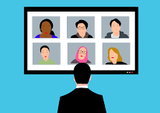
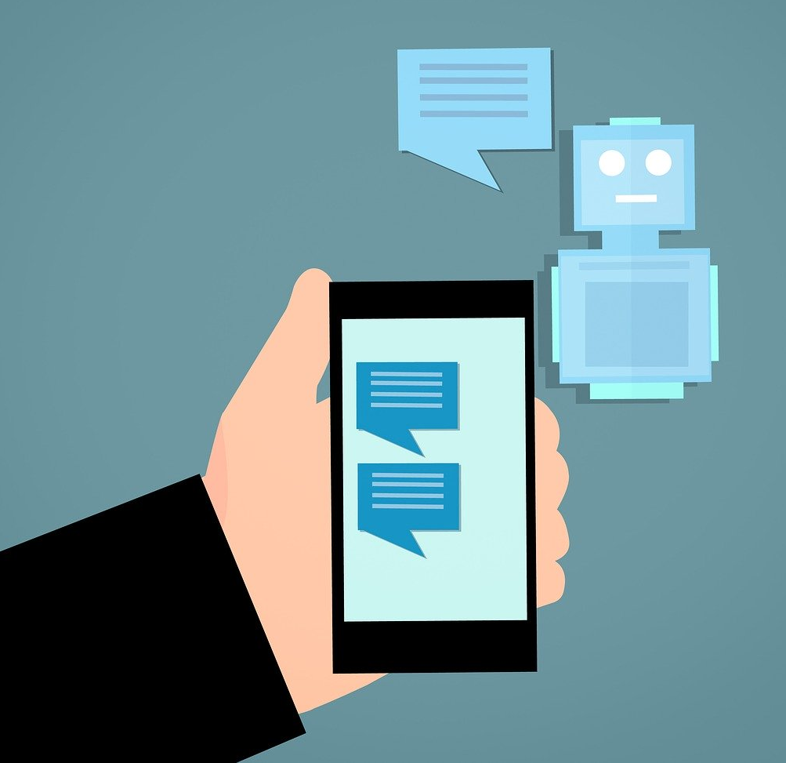

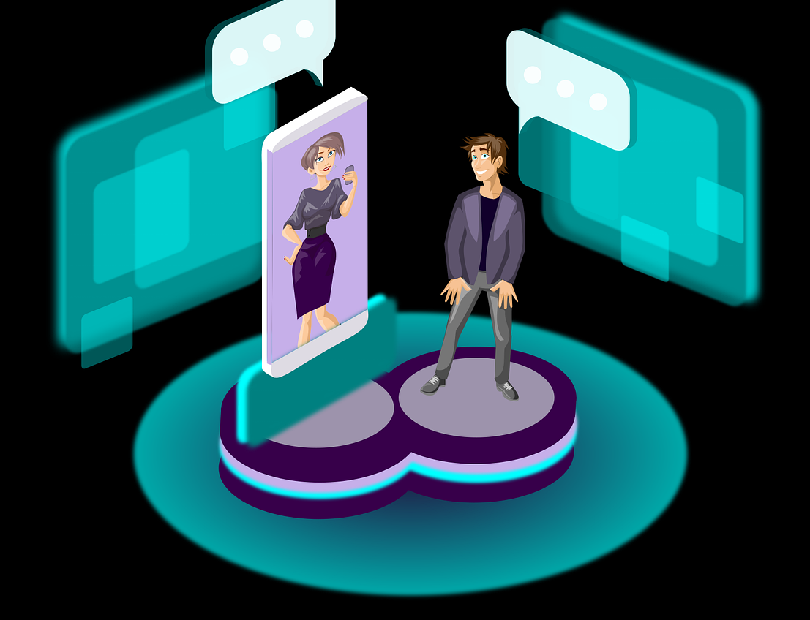
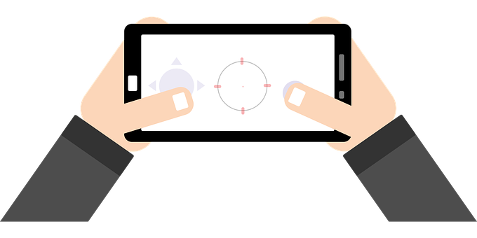
AI Uses in the Modern Workplace Include…
Pre-screening candidates
Job interviews
Conversational agents
Human communication/meeting tools
Workplace productivity/automation
Employee skills gap/training/promotions
Assistive technologies
Environment navigation/transport
Image Credit : PxHere, Pixabay, The Noun Project
Notes:
EXAMPLE TALKING POINTS
Pre-Screening Candidates:
Quickly sort a great volume of applicants and contacts
Scan current employees for good fits for promotions or to identify skills gaps
Analyze current job descriptions and the success rates of past hires when determining their strategies for seeking new hires
Job Interviews
Interviews are conducted over video while algorithms analyze facial expressions, vocal tone, and word choice
They claim to be able to determine “soft skills” and traits like honesty and emotional intelligence
Game based pre-test assessments are used to gauge skills like problem-solving and predict successful hires
Interaction with chatbots is sometimes required to apply
Training & Promotions
Learning analytics used for training and upgrading
Inaccessible training interfaces
Evaluation based on work surveillance
Promotion based on productivity & efficiency metrics

Slide 9


AI Holds Promise for People with Disabilities
Tech solutions for long-standing work barriers to access gainful employment
Innovation for fostering accommodations in the workplace (virtual/physical)
Personalized profiles for accessibility needs based upon data analytics
Customized on-the-job training via intelligent software applications
Analytics for cognitive, physical, and sensory supports for work tasks
Image Credit : PxHere, Pixabay, The Noun Project

Slide 10

AI Presents Workplace Access Challenges
Automated systems screening out highly talented job candidates with disabilities
Biases in data sets for employers and human service providers (disability=outlier)
Intelligent agents running job interviews (e.g., Alexa®, Siri®, Cortana®, Google Assistant®, etc.)
Unwarranted identification of cognitive disabilities (e.g., mental health disabilities, developmental disabilities like autism)
Image Credit: Wikimedia

Slide 11
Panelist Discussion
Panelist Discussion

Slide 12
Examine These Considerations to Implement AI in the Workplace
What data was used? How was the data processed?
Which classification was used?
How were data gaps addressed?
What were the assumptions applied in the analysis?
Is the learning model adaptive and what data will it use for adaptation?
Which decisions will it support? How is this delegated?
How are errors processed?
How can the tool be refined and bugs be fixed?

Slide 13
Learn More and Q&A

Slide 14
Adopt Promising Practices for Buyers
Make a commitment to design and purchase AI recruitment products that do not impede hiring qualified job candidates with disabilities
Collect data and conduct audits to ascertain whether AI designed, purchased, or under consideration for purchase screens out or tends to screen out people with disabilities
Include indemnification clauses in contracts with vendors, requiring vendors to document that they do not use proxies or models that screen out (or tend to screen out) qualified job candidates with disabilities
Foster practices for technology procurement that reflect Universal Design and accessibility features and support assistive technology and services to improve job performance for workers with disabilities who need accommodations
Source: U.S. DOL/ODEP: EARN, Use of AI to Facilitate Employment Opportunities for People with Disabilities

Slide 15

Key Resources
U.S. DOL/ODEP: PEAT Future of Work: AI
U.S. DOL/ODEP: EARN, Use of AI to Facilitate Employment Opportunities for People with Disabilities
U.S. DOL/ODEP: EARN / PEAT, Checklist for Employers: Facilitating the Hiring of People with Disabilities Through the Use of eRecruiting Screening Systems, Including AI
AI Now, Algorithmic Accountability Policy Toolkit
Google, Responsible AI Practices
AI Matters, Considerations for AI Fairness for People with Disabilities, Vol. 5 Issue 3, 3-Sept-2019
U.S. DOL/ODEP: Topic Resource Webpage on Autism

Slide 16

Commemorate National Disability Employment Awareness Month 2020
Download the NDEAM 2020 Poster (English, Spanish):
https://www.dol.gov/agencies/odep/initiatives/ndeam/2020/poster

Slide 17
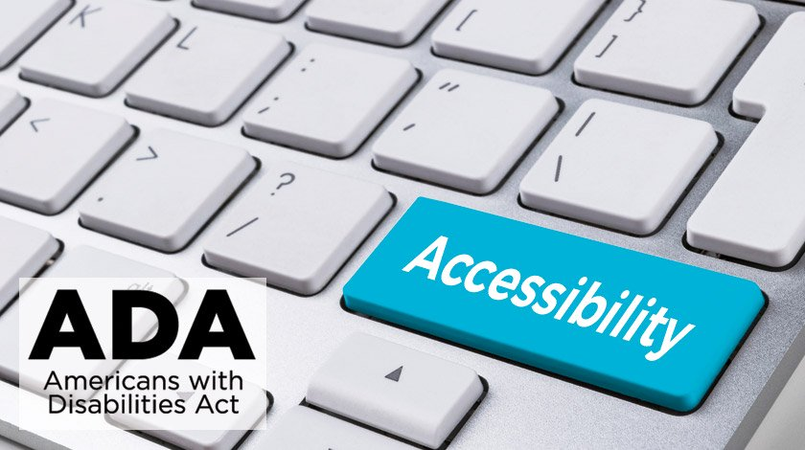
ODEP & OA recognizes 30 years of the ADA with year-long transformative events
Americans with Disabilities Act | July 26, 2020
Learn more at:
ADA30 webpage | https://www.dol.gov/agencies/odep/ada30/
Historical timeline | https://www.dol.gov/agencies/odep/ada30/timeline.htm
Notes:
ODEP

